Slide 1
MPG
Jan 20, 2014

Slide 2
Housekeeping
Holidays
Newcomers
MPG class time
Soldering Competition?
Outline
www.engenuics.com

Slide 3
Coding Conventions
Promotes error-free code
Easier to use, understand and maintain
Simplifies reuse and sharing among classmates
Different standards between all teams and all companies
Usually related to spacing
Some related to PC-Lint and my experience…
I won’t be enforcing it, but you’ll see it in my code and
if(x) y=2; if ( x ) { y = 2; }

Slide 4
Naming
Be clear and informative
Use names in the positive form (i.e. IsValid preferred over IsInvalid)
Functions
Start with file name
Upper CamelCase (LcdInit, LcdPrintf)
Variables
lower camelCase (wasPressed, numUsers)
short but meaningful
Prefix p for pointers, pfn for function pointers (pLed, pfnCallbackWhenDone)
Struct types, Enumerator types, Constants and macros
all UPPERCASE with underscore between words (PI, LCD_TIMEOUT_MS, MY_STRUCT_TYPE)
File names
C source ends in .c; header files in .h
only alphanumeric chars, underscores, plus/minus signs. lower camelCase.

Slide 5
Variables, Operators and Expressions
Avoid global variables
Multiple st
use sizeof to determine a variable’s size
Each operation separated by parentheses u8 myVar = (x + (y * z)); // not (x + y * z)
no “magic” numbers. Constants should be defined instead: #define PI (3.1415)
Multiple static variables within a module should normally be enclosed within a struct to make debugging and maintenance easier.

Slide 6
Statements and Control Flow
Each function should typically have a single return statement, except when checking parameters on entry
Always use a default in switch statements
Break each case of a switch statement
Always use braces to delimit the block in if, for and while statements
For-loops should never have an additional increment/decrement inside the loop

Slide 7
Layout
.h files
#ifndef __FILE_H__ #define __FILE_H__ … #endif
#includes
#defines
Types
Prototypes (same order as implementation file)
.c files
#includes
Local constants
Local static variables
Local function prototypes (same order as implemented)
Global functions
Local functions

Slide 8
Types
typedef int8_t s8;
typedef int16_t s16;
typedef int32_t s32;
typedef uint8_t u8; // same as “char”
typedef uint16_t u16;
typedef uint32_t u32;
#define NULL ((void *) 0)
(bool, true, false)
Least: smallest type with xx bits (i.e. u8l = unsigned char)
Fast: fastest type of size >= x (i.e. u8f on ARM32 = unsigned int)

Slide 9
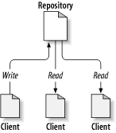
Version Control System
Tracks incremental revisions of files over time
Lets users explore when files changed, why, how and who made the change
Essential when working with a team of developers (or on multiple computers)
Version history is very important for maintenance

Slide 10
SVN vs GIT
SVN uses a centralized repository (server)
Think file server
GIT has multiple repositories (distributed)
Think Dropbox
SVN has been around longer and has better tools
GIT is faster because the entire repository is local
… I use SVN… primarily because of “externals”. GIT uses “sub-modules” but it could still use some better tools before I will switch.

Slide 11
TortoiseSVN
tortoisesvn.net/Downloads
Install
Reboot…

Slide 12
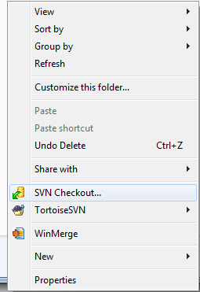
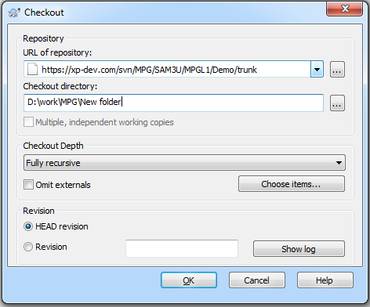
TortoiseSVN
Find a working folder to store MPG code
Right-click on folder and select SVN Checkout
https://xp-dev.com/svn/SeetronTest/trunk
D:\Work\Test
login:
MPGO/university

Slide 13
TortoiseSVN
Find a working folder to store MPG code
Right-click on folder and select SVN Checkout
login:
MPGO/university

